Slide 1
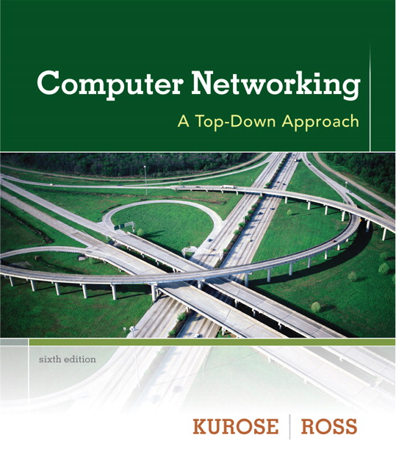
Computer Communications & Networks
CSNC-2413
Lec: 3
Computer Networking: A Top Down Approach 6th edition Jim Kurose, Keith Ross Addison-Wesley March 2012
N/W Architecture & Application Development

Slide 2
Network Architecture
Network communications - a complex task
To deal with this complexity… SIMPLIFY
comm task divided into modules
modules arranged in layers
each layer performs a subset of comm function
Forms a Network Architecture
multiple layers
each layer has one/more Protocols
protocols perform specific comm tasks
provide/obtain services to/from higher/lower layer
Notes:
The long-distance carrier system provided in the United States and throughout the world was designed to transmit voice signals over high-capacity transmission links, such as optical fiber, coaxial cable, and microwave. Part of the evolution of these telecommunications networks to digital technology has been the adoption of synchronous TDM transmission structures. In the United States, AT&T developed a hierarchy of TDM structures of various capacities; this structure is used in Canada and Japan as well as the United States. A similar, but unfortunately not identical, hierarchy has been adopted internationally under the auspices of ITU-T.
The basis of the TDM hierarchy (in North America and Japan) is the DS-1 transmission format. The same DS-1 format is used to provide both multiplexed voice and digital data services. Above the DS-1 data rate of 1.544 Mbps, higher-level multiplexing is achieved by interleaving bits from DS-1 inputs. For example, the DS-2 transmission system combines four DS-1 inputs into a 6.312-Mbps stream. Data from the four sources are interleaved 12 bits at a time. Note that 1.544 × 4 = 6.176 Mbps. The remaining capacity is used for framing and control bits.

Slide 3
Network Architecture
Network Architecture
A structured set of protocols to implement the communications function
application
transport
network
link
physical
Example of a layered network system

Slide 4
Internet protocol stack
Application: support applications (network API)
FTP, SMTP, HTTP, DNS, DHCP
Transport: process-process data transfer (ports)
TCP (reliable), UDP (unreliable)
Network: global addressing (IP addr), routing of pkts from src to dest
IPv4, IPv6
Link: data transfer between neighboring network elements
Ethernet, WiFi (802.11), 3G/4G, PPP
Physical: bits “on the wire”
application
transport
network
link
physical

Slide 5
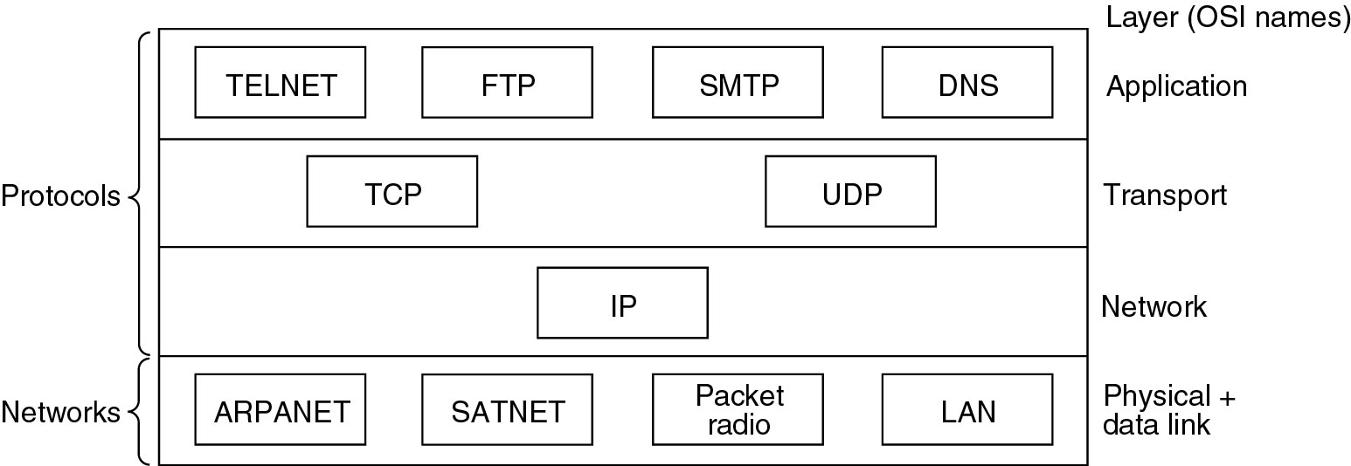
TCP/IP Model
Some of the protocols & networks in TCP/IP protocol stack…
HTTP
FTP
SMTP
DNS
Ethernet
WiFi
3G/4G
PPP

Slide 6
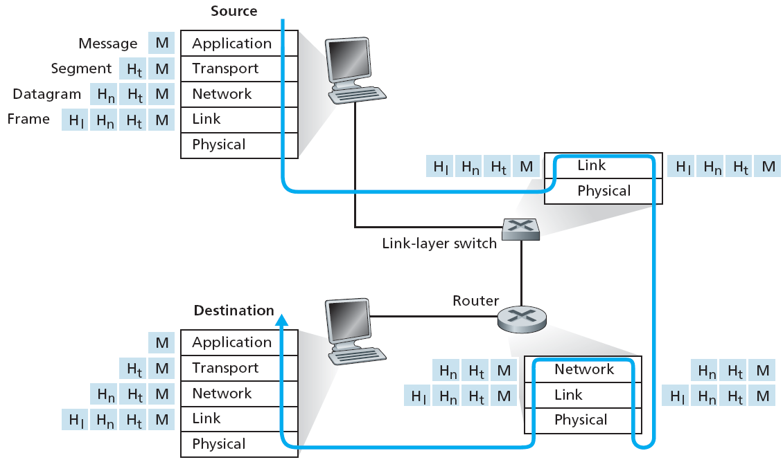
Encapsulation
Data generated by Appl layer
When being sent, each layer appends its header
When being received, each layer removes its header
Principle of Encapsulation & Decapsulation

Slide 7
Why Layered Architecture
Network Architecture - layered architecture
provides modularity
changes in one layer do not require changes in other layers
simplifies system maintenance & upgradation
facilitates process of network evolution
allows to change/improve underlying technologies, with increase in application demands
Notes:
The long-distance carrier system provided in the United States and throughout the world was designed to transmit voice signals over high-capacity transmission links, such as optical fiber, coaxial cable, and microwave. Part of the evolution of these telecommunications networks to digital technology has been the adoption of synchronous TDM transmission structures. In the United States, AT&T developed a hierarchy of TDM structures of various capacities; this structure is used in Canada and Japan as well as the United States. A similar, but unfortunately not identical, hierarchy has been adopted internationally under the auspices of ITU-T.
The basis of the TDM hierarchy (in North America and Japan) is the DS-1 transmission format. The same DS-1 format is used to provide both multiplexed voice and digital data services. Above the DS-1 data rate of 1.544 Mbps, higher-level multiplexing is achieved by interleaving bits from DS-1 inputs. For example, the DS-2 transmission system combines four DS-1 inputs into a 6.312-Mbps stream. Data from the four sources are interleaved 12 bits at a time. Note that 1.544 × 4 = 6.176 Mbps. The remaining capacity is used for framing and control bits.

Slide 8
Some network apps
e-mail
web surfing
search engine
P2P file sharing
text messaging
social networking
remote login
streaming stored video (YouTube, Netflix)
IP radio, TV
multi-user N/W games
voice over IP (Skype, viber)
real-time video conferencing
…..
How these appls are created…

Slide 9


















Creating network apps
application
transport
network
data link
physical
Write appl programs to run only on end systems
appl comm over N/W
web browser comm with server
No need to write software for network-core devices…
network-core devices function at lower layers
confining appls to end systems allows rapid appl development & deployment
application
transport
network
data link
physical
application
transport
network
data link
physical

Slide 10
Application architectures
Possible structures of applications:
client-server
peer-to-peer (P2P)

Slide 11
Client-server architecture
Servers
always-on host
permanent addr (IP & port)
rely on fixed infra-structure
data centers for scaling
Clients
request services from servers
intermittent host connections
dynamic addr (IP & port)
no direct comm with each other
client/server

Slide 12
P2P architecture
NO always-on server
arbitrary end systems comm directly
peers request services from other peers, & also provide services
Self Scalability
new peers bring new service demands
also add new service capacity
Complex Management
peers connect intermittently
change IP addrs
min, or no reliance, on infra-structure
peer-peer

Slide 13
Architectural Challenges
Client Server
Infra-structure intensive
Cost of server hardware, software & access network B/W
System management needs/costs
May become a bottleneck
P2P
Not ISP friendly; require high upload B/W
Security issues
Incentives; users need to volunteer storage, bandwidth & computation resource

Slide 14
How do Appls comm
Applications are processes running on hosts…
Appls within same host
processes usually comm using IPC (Inter Process Comm)
use Pipes, FIFOs, shared memory
Appls in distant hosts
processes comm by exchanging messages
Use sockets, RPC

Slide 15
Next few slides will help you for labs also consider them part of theory

Slide 16
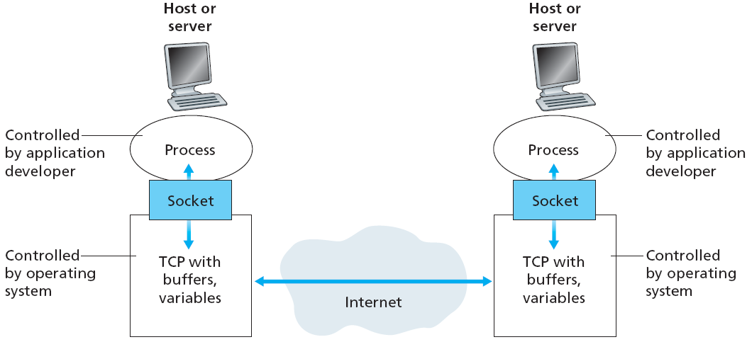
Sockets
Remote processes comm thru sockets…
Socket : “software interface between process & N/W”
Process sends/receives msgs to/from its socket
process reads/writes the socket to receive/send msgs

Slide 17
Process Address
to receive msgs, process must have identifier
host device has unique IP address (32 bits)
but many processes may run on same host
need another level of identifier – Port No (16 bits)
identifier includes both IP address & port number associated with a process on a host…
Socket address
IP addr + Port No
to send HTTP msg to web server gaia.cs.umass.edu…
IP address: 128.119.245.12 port number: 80

Slide 18
Socket Programming
Allows network applications to communicate across an Internet
Socket API mainly provides Transport layer service interface
Stream-sockets for TCP
Datagram-sockets for UDP
Based on client/server architecture
Socket Interface
TCP
UDP
IP
Network Access

Slide 19
Client/Server functions
Client / Server may run on same or different hosts
Client makes Request…
sends message to server to perform a task
Server Responds…
performs task & sends back reply
1. Client sends request
Client
process
Server
process
Resource
4. Client
handles
response
3. Server sends response
2. Server
handles
request
Notes:
Both Can run on the same machine

Slide 20
Servers / Services
Servers : long-running application processes (daemons)
typically created at boot-time by OS
run continuously in background
web server, or mail server
Server waits for requests on a well-known port associated with a particular service
Port 7: echo server
Port 23: telnet server
Port 25: mail server
Port 53: DNS server
Port 80: HTTP server
/etc/services provides list of available services (Linux machine)

Slide 21
Clients
Client – appl launched to access some service, mostly on remote system
web browser, ftp client, telnet client, ssh client
Client does not need well known port
usually assigned ephemeral port by kernel
can also be selected by application
Server - need not know client location
Client - needs to know server location (port + IP address)

Slide 22
Socket
Socket is an endpoint of bidirectional comm…
identified by socket descriptor
Clients & Servers comm with each other thru sockets
open a socket
write data to socket
read data from socket
App
3
2
1
socket
Dest.

Slide 23
Socket Address
The pair IP Address + Port -– makes up a “socket-address”
Client IP address
128.2.194.242
Server IP address
208.216.181.15
Client
Server
3479 is an
ephemeral port allocated by kernel (unix)
53 is a well-known port associated with DNS servers
Client socket address
128.2.194.242:3479
Server socket address
208.216.181.15:53

Slide 24
TCP & UDP Ports
TCP and UDP port numbers ranges:
values 0 – 2¹⁶ (65,536 ports)
Internet Assigned Numbers Authority (IANA)
Well Known Ports (0 - 1023)
used by system processes for well known services
HTTP: 80, E-mail: 25, DNS: 53
Registered Ports (1024 - 49151)
used by vendors for common applications
Web Proxy: 8080, IPSec: 1293, Kaaza: 1214
Dynamic or Ephemeral Ports (49152 - 65535)
used by clients
automatically allocated by kernel on temporary basis

